Slide 1
Top 3 Design Patterns in MapReduce

Slide 2
Agenda
Today we will take you through the following:
Summarization Patterns
Numerical Summarization
Filter Patterns
Finding Top K records
Join Patterns
Reduce side join
Hands On
Hands On
Hands On

Slide 3
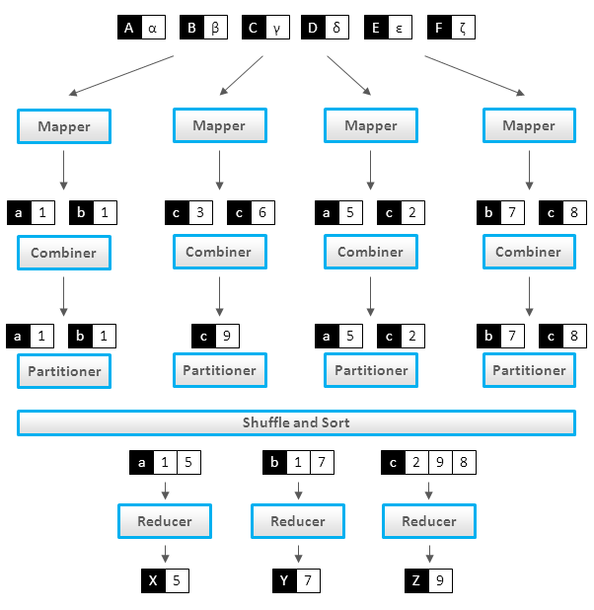
MapReduce Review

Slide 4
Why MapReduce Design Patterns - Question
Let's broach this topic with few questions.
Will you use standard sorting algorithms on MapReduce framework ?
Quick Sort, Merge Sort etc. ??? NO
Why ?
MapReduce imposes constraints like any other framework
You have to think in terms of Map tasks and Reduce tasks
Programmer has little control over many aspects of execution
But MapReduce does provide a number of techniques for controlling flow of data

Slide 5
MapReduce Paradigm - Constraints (Contd.)
Programmer has little control over many aspects of execution
Where a mapper or reducer runs
When a mapper or reducer begins or finishes
Which input key-value pairs are processed by a specific mapper
Which intermediate key-value pairs are processed by a specific reducer

Slide 6
Why MapReduce Design Patterns - Answer
Because of the constraints discussed in earlier slide
Design Patterns help you solve problems and people have learnt to solve these problems in the best possible ways
Because of the MapReduce techniques for controlling execution & flow of data
Use these techniques on problems in standard ways that people have already created
Judicious use of Distributed Cache, Sorting Comparator can help in quite a few algorithms
Scalability & Efficiency concerns

Slide 7
Summarization Patterns – What is it
Provides high level aggregate view of data set when visual inspection of whole data not feasible
Group similar data together and perform an operations like
Calculating a statistic, indexing, counting etc.
Apply on a new dataset to quickly understand what's important and what to look closely at
Example
Number of hits per hour per location on a website in a web log
Average length of comments / user in blog comments
Top ten salary per profession region-wise

Slide 8
Numerical Summarizations – Description
General Pattern for calculating aggregate statistic on the dataset
Group records by a key field and calculate a numerical aggregate per group
Min, max, sum, average, median, standard deviation etc.
Use Combiner properly for efficient implementation
Example
Take advertising actions based on hours users are most active on your site
Group hourly average amount users spend on your site
Applicability – Use it when
You are dealing with numerical data or counting
The data can be grouped by fields

Slide 9
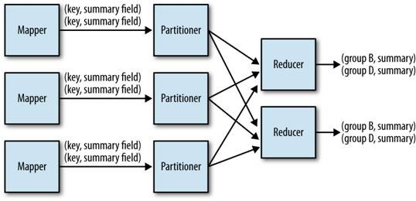
Numerical Summarizations – Structure
Mapper
Output Key = field to group by; Output Value = numerical item to summarize on
Make sure only relevant items are output from Map to Reduce network traffic
Combiner
Use if summarization operation on reducer is Associative & Commutative
Will reduce the network traffic between Map tasks & Reduce tasks

Slide 10
Numerical Summarizations – Structure (Contd.)
Partitioner
Use custom partitioner if you feel skew in the data
To distribute computation uniformly across reducers
Reducer
Each reducer applies summarization function on the data set received on the group key
Output key = group key; summarization statistic
Job output is a set of part files containing a single record per reducer input group

Slide 11
Numerical Summarizations – Analogy, Performance
Performance
The crux of this pattern – Grouping by key – is what MapReduce provides at it's core
Performs well when combiner is used properly
For skewed dataset, use custom partitioner for improved performance
Use appropriate number of reducers

Slide 12
Numerical Summarizations – Use Cases
Min/Max/Count
Analytics to find minimum, maximum, count of an event
Average/Median/Standard Deviation
Analytics similar to Min/Max/Count
Implementation not as straight forward as operations not associative
Record Count
Common analytics to get a heartbeat of data flow rate on a particular interval
Word Count
Basic Text Analytics of word count in a document
Hello World of MapReduce

Slide 13
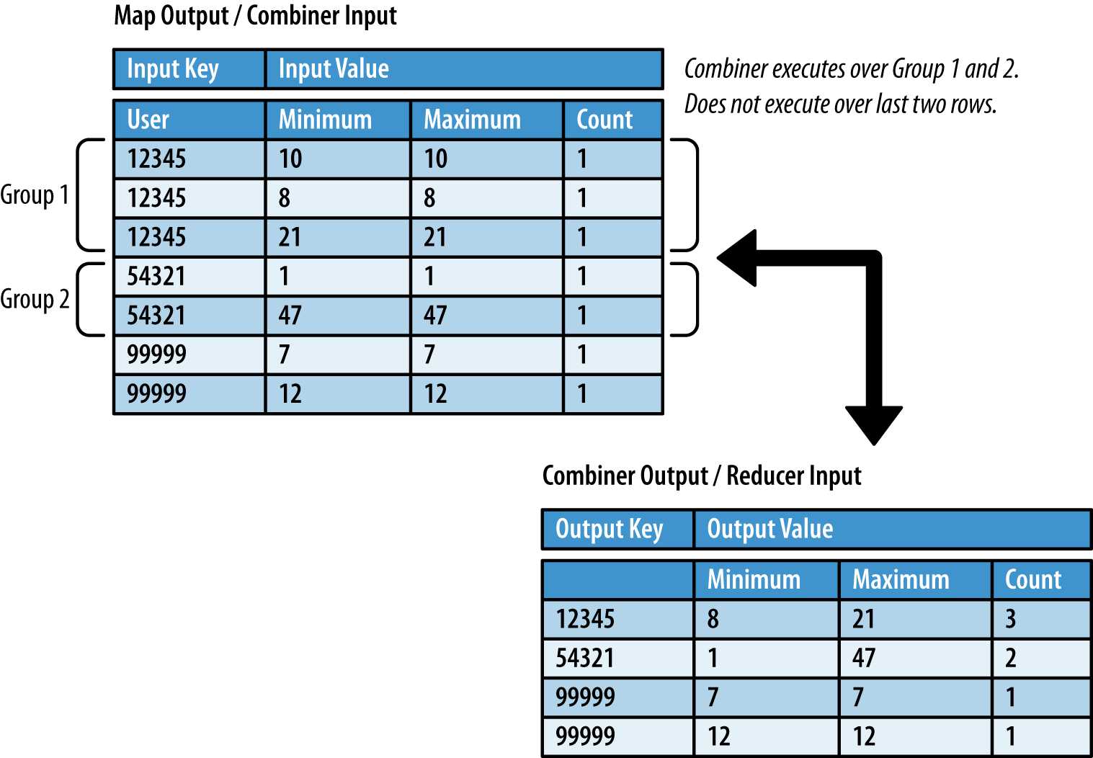
Min/Max/Count Example – Data Flow

Slide 14
Min/Max/Count Example
DEMO

Slide 15
Filtering Patterns – What is it
Finding a subset of interest from a large data set
So that further analytics can be applied on this subset
These patterns don't alter the original dataset
Example:
Sampling – to get a representative sample to apply on Machine Learning Algorithms
Selecting all records for a user to apply further analytics
Notes:
Title and Content Slide – Font: Tahoma 12/14 (depending on the amount of text)
Heading: Calibri Heading 26 (consistent)
Bullet code – 174 for bullet
OOBB for sub bullet
15

Slide 16
Basic Filtering Pattern – Description
Acts as a basic filtering abstract pattern for some other patterns
Filter out records that are not of interest and keep the ones that are
Parallel processing system like Hadoop is required due to large size of original data set
Filtered in subset may be large or small
Example: To study behaviour of users between 10-11am filter out records from log file
Applicability – Use it when
Widely applicable
Use it when data can be easily parsed to yield a filtering criteria
Notes:
Title and Content Slide – Font: Tahoma 12/14 (depending on the amount of text)
Heading: Calibri Heading 26 (consistent)
Bullet code – 174 for bullet
OOBB for sub bullet
16

Slide 17
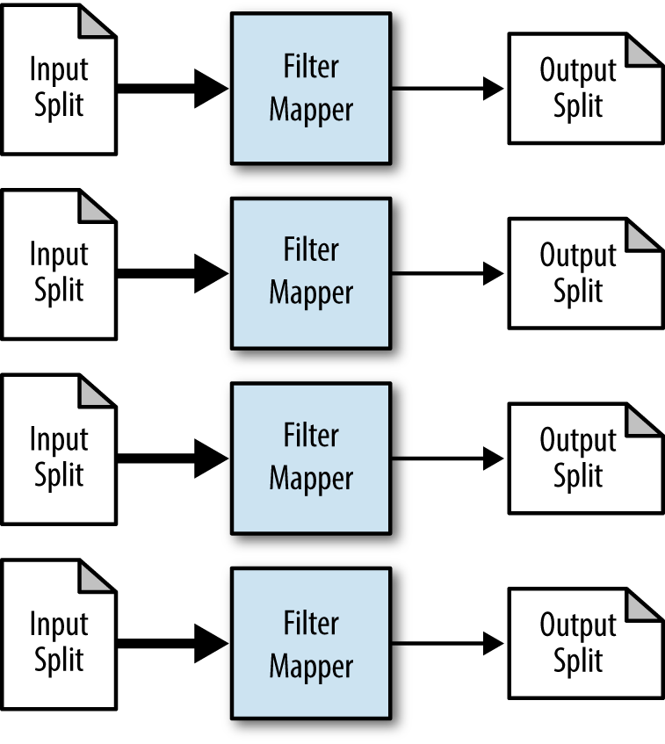
Basic Filtering Pattern – Structure
Notes:
Title and Content Slide – Font: Tahoma 12/14 (depending on the amount of text)
Heading: Calibri Heading 26 (consistent)
Bullet code – 174 for bullet
OOBB for sub bullet
17

Slide 18
Basic Filtering Pattern – Description
Mapper
Applies filtering criteria to each record it receives
Outputs records that match filtering in criteria
Output key/value pairs same as input key/value pairs
Combiner
Not Required; map only job
Partitioner
Not Required; map only job
Reducer
Generally Not Required ; Map Only job
But can use Identity reducers
Notes:
Title and Content Slide – Font: Tahoma 12/14 (depending on the amount of text)
Heading: Calibri Heading 26 (consistent)
Bullet code – 174 for bullet
OOBB for sub bullet
18

Slide 19
Basic Filtering Pattern – Use Cases
Closer view of data
Removing low scoring data
Distributed grep
Data cleansing
Simple random sampling
Tracking a thread of events
Notes:
Title and Content Slide – Font: Tahoma 12/14 (depending on the amount of text)
Heading: Calibri Heading 26 (consistent)
Bullet code – 174 for bullet
OOBB for sub bullet
19

Slide 20
Top Ten – Description
Filter in a fixed and relatively small number (10) of records from a large data set
Based on a total ordering ranking criteria
You can manually look at this small number of records to see what's special about them
Important in terms of how one would implement Top Ten in MapReduce vis-a-vis SQL
In SQL or any programming language you would sort and then take top 10
In Map Reduce total order sorting is complex and resource intensive
Example: Top ten users with highest number of comments posted on Stackoverflow in 2014
Notes:
Title and Content Slide – Font: Tahoma 12/14 (depending on the amount of text)
Heading: Calibri Heading 26 (consistent)
Bullet code – 174 for bullet
OOBB for sub bullet
20

Slide 21
Top Ten – Applicability
Applicability – Use it when
A comparator function is available for ranking records
Number of output records much smaller than input records
If not, one is better off sorting the whole dataset
Notes:
Title and Content Slide – Font: Tahoma 12/14 (depending on the amount of text)
Heading: Calibri Heading 26 (consistent)
Bullet code – 174 for bullet
OOBB for sub bullet
21

Slide 22
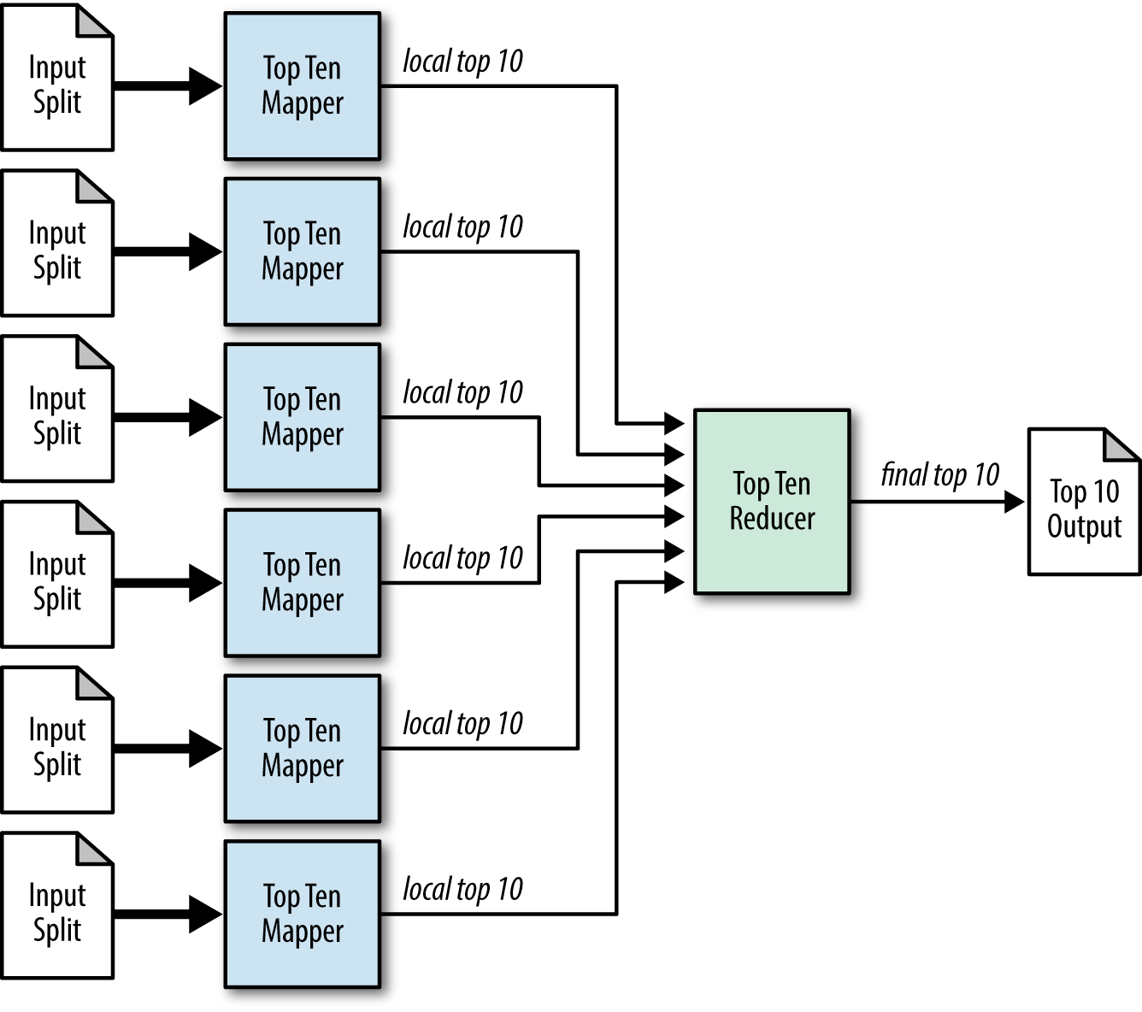
Top Ten – Structure
Notes:
Title and Content Slide – Font: Tahoma 12/14 (depending on the amount of text)
Heading: Calibri Heading 26 (consistent)
Bullet code – 174 for bullet
OOBB for sub bullet
22

Slide 23
Top Ten – Structure
Mapper
In setup() method initialize an array of size k(=10)
In map(), insert record field into array in a sorted way
If sizeOf(array) truncate array to size == 10, keeping highest 10
In cleanup() read the array and output key = null and value = record
Combiner and custom Partitioner not required
Reducer
Considering number of output records from mapper is small only 1 reducer is used
Reducer does things similar to mapper
Notes:
Title and Content Slide – Font: Tahoma 12/14 (depending on the amount of text)
Heading: Calibri Heading 26 (consistent)
Bullet code – 174 for bullet
OOBB for sub bullet
23

Slide 24
Top Ten – Use Cases
Outlier analysis
Select interesting data for further BI systems which cannot handle Big Data sets
Publish interesting dashboards
Notes:
Title and Content Slide – Font: Tahoma 12/14 (depending on the amount of text)
Heading: Calibri Heading 26 (consistent)
Bullet code – 174 for bullet
OOBB for sub bullet
24

Slide 25
Top Ten Example
DEMO
Notes:
Title and Content Slide – Font: Tahoma 12/14 (depending on the amount of text)
Heading: Calibri Heading 26 (consistent)
Bullet code – 174 for bullet
OOBB for sub bullet
25

Slide 26
Join Patterns – What is it
Datasets generally exist in multiple sources
Deriving full-value requires merging them together
Join Patterns are used for this purpose
Performing joins on the fly on Big Data can be costly in terms of time
Example: Joining StackOverflow data from Comments & Posts on UserId
Notes:
Title and Content Slide – Font: Tahoma 12/14 (depending on the amount of text)
Heading: Calibri Heading 26 (consistent)
Bullet code – 174 for bullet
OOBB for sub bullet
26

Slide 27
Join – Refresher
Inner Join
Outer Join
Left Outer Join
Right Outer Join
Full Outer Join
Anti Join
Cartesian Product
Notes:
Title and Content Slide – Font: Tahoma 12/14 (depending on the amount of text)
Heading: Calibri Heading 26 (consistent)
Bullet code – 174 for bullet
OOBB for sub bullet
27

Slide 28
Reduce Side Join – Description
Easiest to implement but can be longest to execute
Supports all types of join operation
Can join multiple data sources, but expensive in terms of network resources & time
All data transferred across network
Example : Join PostLinks table data in StackOverflow to Posts data
Notes:
Title and Content Slide – Font: Tahoma 12/14 (depending on the amount of text)
Heading: Calibri Heading 26 (consistent)
Bullet code – 174 for bullet
OOBB for sub bullet
28

Slide 29
Reduce Side Join – Description (Contd.)
Applicability – Use it when
Multiple large data sets require to be joined
If one of the data sources is small look at using replicated join
Different data sources are linked by a foreign key
You want all join operations to be supported
Notes:
Title and Content Slide – Font: Tahoma 12/14 (depending on the amount of text)
Heading: Calibri Heading 26 (consistent)
Bullet code – 174 for bullet
OOBB for sub bullet
29

Slide 30
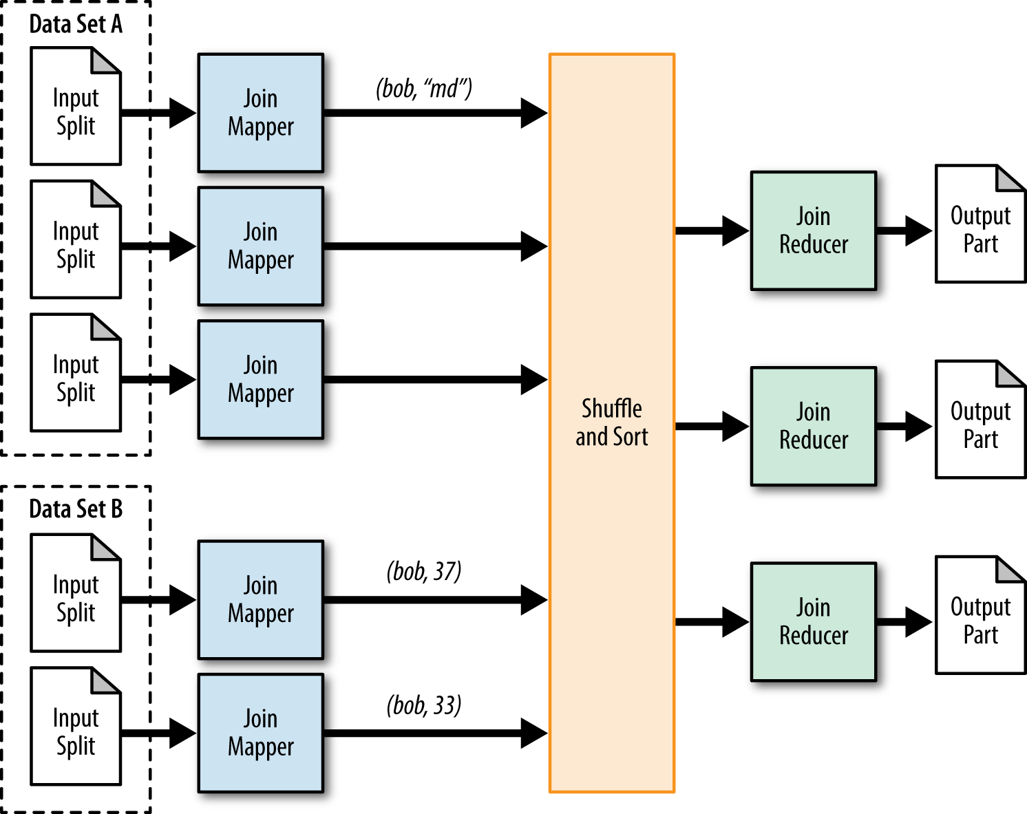
Reduce Side Join – Structure
Notes:
Title and Content Slide – Font: Tahoma 12/14 (depending on the amount of text)
Heading: Calibri Heading 26 (consistent)
Bullet code – 174 for bullet
OOBB for sub bullet
30

Slide 31
Reduce Side Join – Structure (Contd.)
Mapper
Output key should reflect the foreign key
Value can be the whole record and an identifier to identify the source
Use projection and output only the required number of fields
Combiner
Not Required ; No additional benefit
Partitioner
User Custom Partitioner if required;
Reducer
Reducer logic based on type of join required
Reducer receives the data from all the different sources per key
Notes:
Title and Content Slide – Font: Tahoma 12/14 (depending on the amount of text)
Heading: Calibri Heading 26 (consistent)
Bullet code – 174 for bullet
OOBB for sub bullet
31

Slide 32
Reduce Side Join – Performance
Performance
The whole data moves across the network to reducers
You can optimize by using projection and sending only the required fields
Number of reducers typically higher than normal
If you can use any other Join type for your problem, use that instead
Notes:
Title and Content Slide – Font: Tahoma 12/14 (depending on the amount of text)
Heading: Calibri Heading 26 (consistent)
Bullet code – 174 for bullet
OOBB for sub bullet
32

Slide 33
Reduce Side Join Example
DEMO
Notes:
Title and Content Slide – Font: Tahoma 12/14 (depending on the amount of text)
Heading: Calibri Heading 26 (consistent)
Bullet code – 174 for bullet
OOBB for sub bullet
33

Slide 34
Demo

Slide 36
Survey

